Slide 1
Object Oriented Programming
Week 9

Slide 2
Friend Functions
A friend function of a class is defined outside that class’s scope, yet has the right to access the non-public (and public) members of the class. friend function can be
Standalone functions,
entire classes or
member functions of other classes may be declared to be friends of another class.

Slide 3
Friend Functions
The functions which are not member functions of the class yet they can access all private members of the class are called friend functions.
If a function is defined as a friend function then, the private and protected data of a class can be accessed using the function.
The complier knows a given function is a friend function by the use of the keyword friend.

Slide 4
Why they are needed?
They are needed in situations where we have written code for some function in one class and it need to be used by other classes as well for example, suppose we wrote the code to compute a complex mathematical formula in one class but later it was required by other classes as well, in that case we will make that function friend of all other classes.

Slide 5
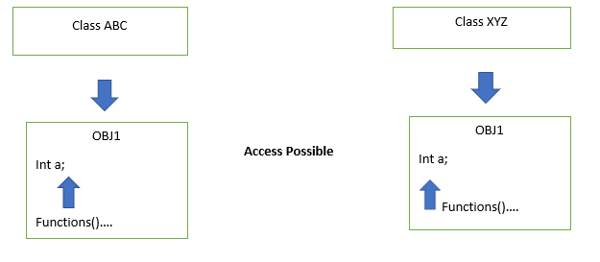
Why they are needed?

Slide 6
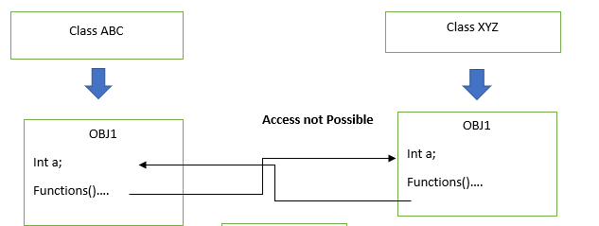
Why they are needed?

Slide 7
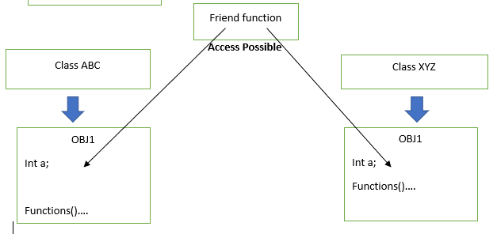
Why they are needed?

Slide 8
Are friend functions against the concept of Object Oriented Programming?
One of the important concepts of OOP is data hiding, i.e.,
a nonmember function cannot access an object's private or protected data.
But, sometimes this restriction may force programmer to write long and complex codes. So, there is mechanism built in C++ programming to access private or protected data from non-member functions.This is done using a friend function or/and a friend class.
It can be said that friend functions are against the principle of object oriented programming because they violate the principle of encapsulation which clearly says that each object methods and functions should be encapsulated in it. But there we are making our private member accessible to other outside functions.

Slide 9
Consider the following class
class X {
private:
int a, b;
public:
void MemberFunction (); }
Suppose we have a global function DoSomething that need to access the private members of class X, when we will try to access them compiler will generate error as outside world cannot access private members of a class except its member functions.

Slide 10
Friend Functions
void DoSomething(X obj) {
obj.a = 3; //Error
obj.b = 4; //Error }
In order to access the member variables of the class, we must make function friend of that class

Slide 11
Friend Functions
class X {
private:
int a, b;
public:
friend void DoSomething(X obj); }
Now the function DoSomething can access data members of class X
void DoSomething(X obj) {
obj.a = 3;
obj.b = 4; }

Slide 12
Friend Functions
Prototypes of friend functions appear in the class definition. But friend functions are NOT member functions.
Friend functions can be placed anywhere in the class without any effect Access specifiers don’t affect friend functions or Classes.

Slide 13
Friend Functions
class X{
...
private:
friend void DoSomething(X); public: friend void DoAnything(X);
...
} ;
While the definition of the friend function is:
void DoSomething(X obj)
{ obj.a = 3; // No Error obj.b = 4; // No Error
…
}
friend keyword is not given in definition.

Slide 14
global friend function
#include <iostream>
using namespace std;
class Box {
double width;
public:
friend void printWidth( Box box );
void setWidth( double wid );};
void Box::setWidth( double wid ) {
width = wid;}
void printWidth( Box box ) {
cout << "Width of box : " << box.width <<endl;}

Slide 15
global friend function
int main() {
Box box;
box.setWidth(10.0);
printWidth( box );
return 0;
}

Slide 16
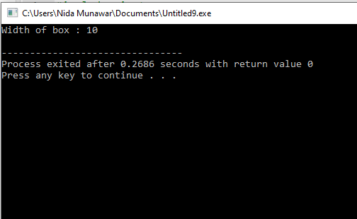
global friend function

Slide 17
Inline friend definitions
Friend functions can be defined (given a function body) inside class declarations. These functions are inline functions, and like member inline functions they behave as though they were defined immediately after all class members have been seen but before the class scope is closed (the end of the class declaration). Friend functions that are defined inside class declarations are in the scope of the enclosing class.
Remember friends are not member functions you cannot access it through the object of class.

Slide 18
Inline friend definitions
class Box {
double width;
public:
friend void printWidth( Box box ){
cout << "Width of box : " << box.width <<endl;}
void setWidth( double wid ){
width = wid;}};
int main() {
Box box;
box.setWidth(10.0);
printWidth( box );
return 0;}

Slide 19
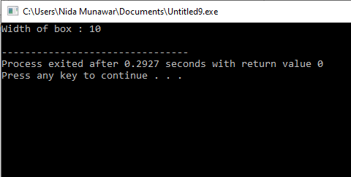
Inline friend definitions

Slide 20
friend function of another class
member functions of other classes may be declared to be friends of another class

Slide 21
friend function of another class
class B;
class A {
public:
void showB(B);};
class B {
int b;
public:
B() { b = 0; }
friend void A::showB(B x);}; // Friend function
void A::showB(B x){
cout << "B::b = " << x.b;}

Slide 22
friend function of another class
int main(){
A a;
B x;
a.showB(x);
return 0;}

Slide 23
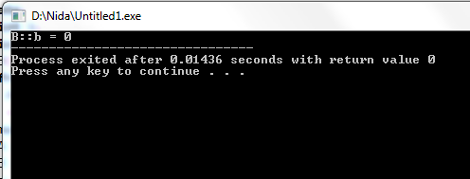
friend function of another class

Slide 24
Addition of members of two different classes using friend Function (Multiple friends)
#include <iostream>
using namespace std;
class B;
class A {
private:
int numA;
public:
A(): numA(12) { }
friend int add(A, B);};

Slide 25
Multiple friends
class B {
private:
int numB;
public:
B(): numB(1) { }
friend int add(A , B);};
int add(A objectA, B objectB){
return (objectA.numA + objectB.numB);}

Slide 26
Multiple friends
int main()
{
A objectA;
B objectB;
cout<<"Sum: "<< add(objectA, objectB);
return 0;
}

Slide 27
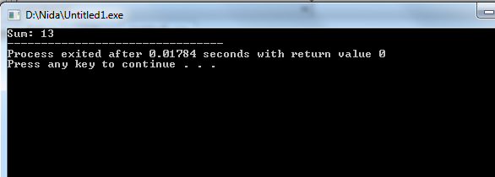
Multiple friends

Slide 28
Friend Classes:
A friend class can access private and protected members of other class in which it is declared as friend. It is sometimes useful to allow a particular class to access private members of other class.
To declare all member functions of class ClassTwo as friends of class ClassOne, place a declaration of the form
friend class ClassTwo;
in the definition of class ClassOne.

Slide 29
Syntax
... .. ...
class B;
class A
{
// class B is a friend class of class A
friend class B;
... .. ...
}
class B
{
... .. ...
}

Slide 30
Friend Classes:
When a class is made a friend class, all the member functions of that class
becomes friend functions.
In this program, all member functions of class B will be friend functions of
class A.
Thus, any member function of class B can access the private and protected
data of class A.
But, member functions of class A cannot access the data of class B.

Slide 31
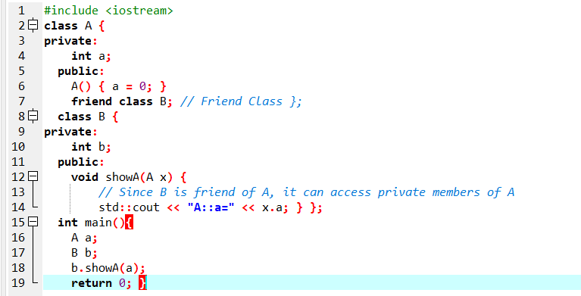
Friend Classes:

Slide 32
Example code
#include <iostream>
using namespace std;
class YourClass {
friend class YourOtherClass; // Declare a friend class
public:
YourClass() : topSecret(0){}
void printMember() { cout << topSecret << endl; }
private:
int topSecret;};
class YourOtherClass {
public:
void change( YourClass& yc, int x ){
yc.topSecret = x;}};

Slide 33
Example code
int main() {
YourClass c1;
YourOtherClass oc1;
c1.printMember();
oc1.change(c1, 5 );
c1.printMember();}

Slide 34
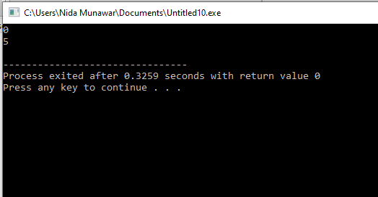
Example code

Slide 35
Friendship is not mutual/symmetric
Friendship is granted, not taken—i.e.,
for class B to be a friend of class A, class A must explicitly declare that class B is its friend.
Friendship is not mutual unless explicitly specified
In the above example, member functions of YourClass cannot access the private members of YourOtherClass.

Slide 36
Friendship is not transitive
if class A is a friend of class B, and class B is a friend of class C, you cannot infer that class A is a friend of class C
Friendship is not transitive, so classes that are friends of YourOtherClass cannot access YourClass's private members.

Slide 37
Friendship is not inherited
In C++, friendship is not inherited. If a base class has a friend function, then the function doesn’t become a friend of the derived class(es).
Friendship is not inherited, meaning that classes derived from YourOtherClass cannot access YourClass's private members.

Slide 38
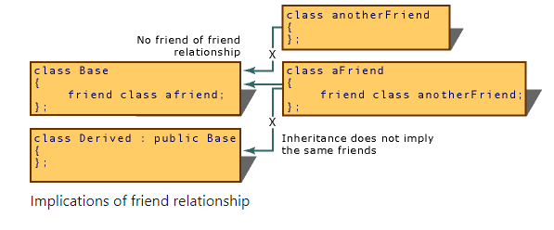
Implications of friendship

Slide 39
Friendship is not inherited
A friend of Child can access protected and public members of Parent via Child,
but NOT private members.
To access private members of Parent, the friend function must be explicitly declared
in Parent as well.

Slide 40
Example code
#include <iostream>
using namespace std;
class Parent {
private:
int privateData = 100;
protected:
int protectedData = 200;
public:
int publicData = 300;
Parent() {
cout << "Parent Constructor Called\n";
}};
class Child : public Parent {
public:
Child() {
cout << "Child Constructor Called\n"; }

Slide 41
Example code
friend void friendFunctionOfDerived(const Child& c);
};
void friendFunctionOfDerived(const Child& c) {
cout << "Accessing Parent's Protected Data via Derived: " << c.protectedData << endl;
cout << "Accessing Parent's Public Data: " << c.publicData << endl;
}
int main() {
Child obj;
cout << "\nCalling Friend Function of Derived Class:\n";
friendFunctionOfDerived(obj);
return 0;
}

Slide 42
Overloaded friend Functions
It’s possible to specify overloaded functions as friends of a class.
Each function intended to be a friend must be explicitly declared in the class definition as a friend of the class.

Slide 43
Overloaded friend Functions
class Distance {
int meter;
friend int addFive(Distance);
friend int addFive(Distance , int);
public:
Distance() : meter(0) {}};
int addFive(Distance d) {
d.meter += 5;
return d.meter;}
int addFive(Distance d , int i) {
d.meter += i;
return d.meter;}

Slide 44
Overloaded friend Functions
int main() {
Distance D;
cout << "Distance: " << addFive(D) <<endl;;
cout << "Distance overloaded: " << addFive(D,6);
return 0;}

Slide 45
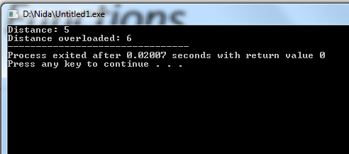
Overloaded friend Functions

Slide 46
Operator Functions as Class Members vs. Global Functions
Operator functions can be member functions(already discussed)
or global functions (non-member function)
global functions are often made friends for performance reasons.
performance reasons?

Slide 47
performance reasons
It’s possible to overload an operator as a global, non-friend function, but such a function requiring access to a class’s private or protected data would need to use set or get functions provided in that class’s public interface. The overhead of calling these functions could cause poor performance, so these functions can be inlined to improve performance.

Slide 48
some criteria/rules to define the operator function:
Member functions use the this pointer implicitly to obtain one of their class object arguments (the left operand for binary operators).
Arguments for both operands of a binary operator must be explicitly listed in a global function call

Slide 49
some criteria/rules to define the operator function:
In case of a non-static function, the binary operator should have only one argument and unary should not have an argument.
In the case of a friend function, the binary operator should have only two argument and unary should have only one argument.

Slide 50
Operator Overloading using a Friend function
In this approach, the operator overloading function must precede with friend keyword, and declare a function class scope. Keeping in mind, friend operator function takes two parameters in a binary operator, varies one parameter in a unary operator. All the working and implementation would same as binary operator function except this function will be implemented outside of the class scope.

Slide 51
Operator Overloading using a Friend function
In case of a non-static function, the binary operator should have only one argument and unary should not have an argument.
In the case of a friend function, the binary operator should have only two argument and unary should have only one argument.

Slide 52
Syntax for binary operator overloading using friend function
friend return-type operator operator-symbol (Variable 1, Varibale2) { //Statements; }

Slide 53
Overloading Binary Operator using a Friend function
class Distance {
public:
int feet, inch;
Distance() {
this->feet = 0;
this->inch = 0; }
Distance(int f, int i) {
this->feet = f;
this->inch = i; }
friend Distance operator+(Distance, Distance); };

Slide 54
Overloading Binary Operator using a Friend function
Distance operator+(Distance d1, Distance d2) {
Distance d3;
d3.feet = d1.feet + d2.feet;
d3.inch = d1.inch + d2.inch;
return d3; }
int main() {
Distance d1(8, 9);
Distance d2(10, 2);
Distance d3;
d3 = d1 + d2;
cout << "\nTotal Feet & Inches: " << d3.feet << "'" << d3.inch;
return 0; }

Slide 55
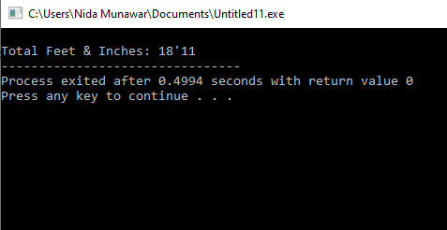
Overloading Binary Operator using a Friend function

Slide 56

Overloading Binary Operator using a Friend function
Another way of calling binary operator overloading with friend function is to call like a non member function as follows,

Slide 57
Unary operator overloading using Friend function
class UnaryFriend{
int a=10;
int b=20;
public:
void getvalues(){
cout<<"Values of A and B\n";
cout<<a<<"\n"<<b<<"\n"<<endl;}
void friend operator-(UnaryFriend &x); };
void operator-(UnaryFriend &x){
x.a = -x.a; //Object name must be used as it is a friend function
x.b = -x.b;}

Slide 58
Unary operator overloading using Friend function
int main(){
UnaryFriend x1;
cout<<"Before Overloading\n";
x1.getvalues();
cout<<"After Overloading \n";
-x1;// operator-(x1);
x1.getvalues();
return 0;}

Slide 59
To distinguish between prefix and postfix add a dummy int datatype in postfix
E.g.
Friend void operator--(UnaryFriend x , int dummy)

Slide 60
some criteria/rules to define the operator function:
Operator overloading function can be applied on a member function if the left operand is an object of that class, but if the Left operand is different, then the Operator overloading function must be defined as a non-member function.

Slide 61
When to use a member function for operator overloading?
If the left operand of the operator is an object of the same class,
the operator overloading function can be implemented as a member function.
It automatically passes the left operand (this) to the function.
When to use a non-member (friend) function?
If the left operand is not an object of the class, we must define the operator
overloading function as
a non-member function (usually a friend function) so that it can access private members.

Slide 62
Member Function (Left Operand is an Object of the Class)
#include <iostream>
using namespace std;
class Number {
int value;
public:
Number(int v) : value(v) {}
// Overloading + operator as a member function
Number operator+(const Number& obj) {
return Number(value + obj.value); }
void display() { cout << "Value: " << value << endl; }};
int main() {
Number n1(10), n2(20);
Number result = n1 + n2; // Works because n1 is an object of Number
result.display();
return 0;}

Slide 63
Non-Member Function (Left Operand is Not an Object of the Class)
#include <iostream>
using namespace std;
class Number {
int value;
public:
Number(int v) : value(v) {}
// Friend function to overload + when left operand is int
friend Number operator+(int lhs, const Number& obj);
void display() { cout << "Value: " << value << endl; }};
// Overloading + when left operand is an int
Number operator+(int lhs, const Number& obj) {
return Number(lhs + obj.value);}

Slide 64
int main() {
Number n(30);
Number result = 10 + n; // Left operand is int, not a Number object
//operator+(10, obj); Equivalent to 10+n
result.display();
return 0;}

Slide 65
Why Does obj + int Work in a Class Member Function?
class Number {
int value;
public:
Number(int v) : value(v) {}
Number operator+(int rhs) {
return Number(value + rhs);
}};
int main() {
Number n1(10);
Number result = n1 + 5; // Works fine
//n1.operator+(5).
}

Slide 66
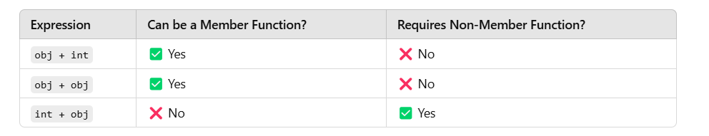

Slide 67
Task
Calculate Area of Triangle the one class is acute angle(less than 90 degree) and another one is obtuse angle (greater than 90 degree) both class wants to access only one function which is “Area of Triangle” which is independent of all classes.

